Slide 1
High Performance Computing in Life Sciences Part I PartII HPC Introduction BioComputing Sofware Introduction
Oleksandr Moskalenko
om@ufl.edu
Matt Gitzendanner
magitz@ufl.edu

Slide 2
Summary
The scale of biocomputing challenges
The evolution of High-Performance Computing
Current state of the traditional computing
Parallelizing analyses
Traditional multiprocessing
Hadoop
Specialized approaches
The interfaces
GUI vs. Web vs. Batch (comman-line)
Biocomputing Software (Part II)

Slide 3
Historical Perspective
From a molecule to millions of genomes
Notes:
Differs from the traditional HPC in how nodes are provisioned

Slide 4
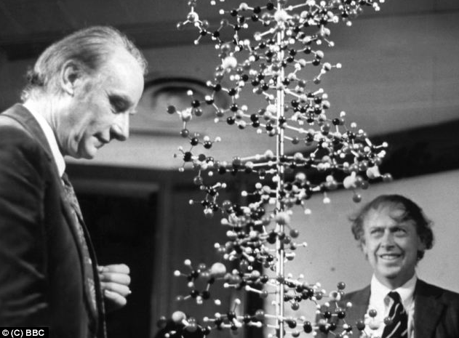
The Beginning

Slide 5
Sequencing Data Scaling
Genome Size * Coverage
Viral – 1-100kbp
Bacteria, Archaea – 1-10Mbp
Simple Eukaryotes – 10-100 Mbp
Animals, Plants – 100Mbp - > 100Gbp
Sequencing Coverage
~10x in the Sanger Shotgun WGS times
~30x for an average analysis
~100x for metagenomic studies
Up to ~1000x for low-frequency SNP analysis in mixed samples

Slide 6
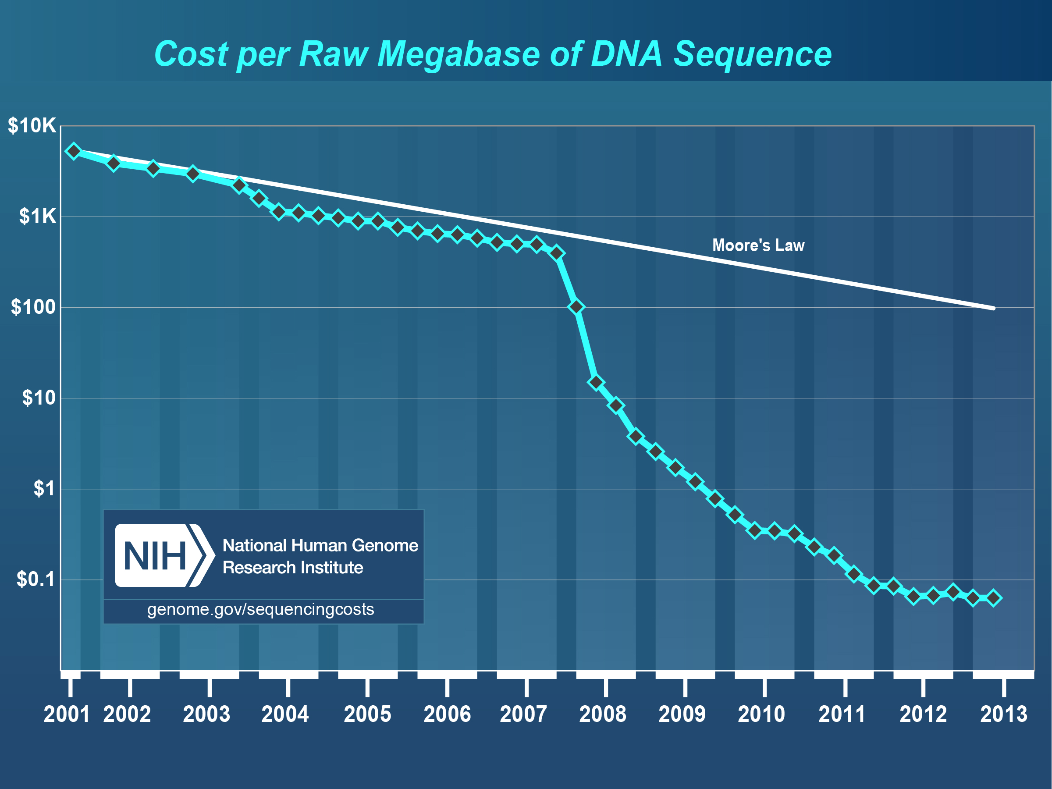

Slide 7
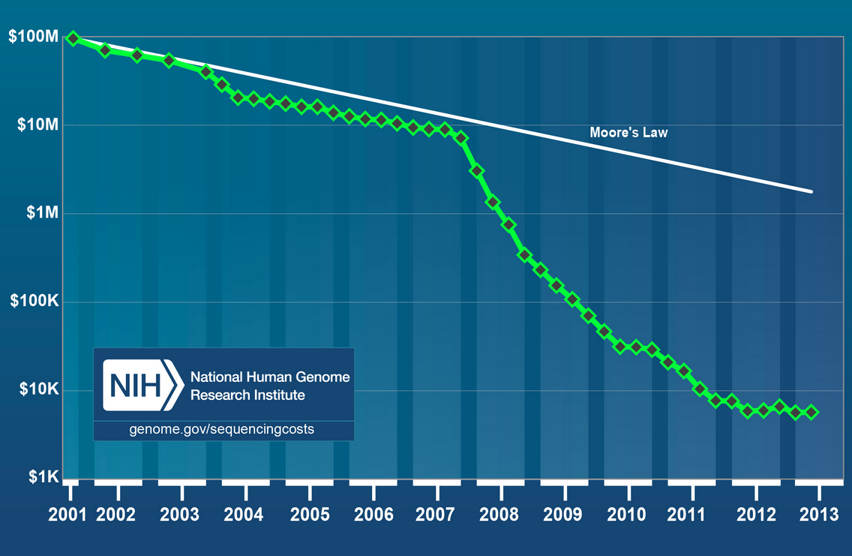

Slide 8
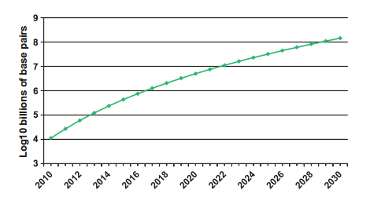
Growth of Sequencing Data
10⁶ (Mb) -> 10⁹ (Gb) -> 10¹² (Tb) -> 10¹⁵ (Pb) -> 10¹⁸ (Eb) -> 10²¹ (Zb)
Grossman et al. (2011)
Notes:
2013 = over 1PB of sequencing data in OSDC

Slide 9
Growth of Sequencing Data
1 Gigabyte: A pickup truck filled with paper OR A symphony in high-fidelity sound OR A movie at TV quality
10 Terabytes: The printed collection of the US Library of Congress
2 Petabytes: All US academic research libraries
5 Exabytes: All words ever spoken by human beings.
2.7 Zettabytes: the total amount of global data in 2012 (IDC).
10⁶ (Mb) -> 10⁹ (Gb) -> 10¹² (Tb) -> 10¹⁵ (Pb) -> 10¹⁸ (Eb) -> 10²¹ (Zb)
Grossman et al. (2011)
Notes:
2013 = over 1PB of sequencing data in OSDC

Slide 10
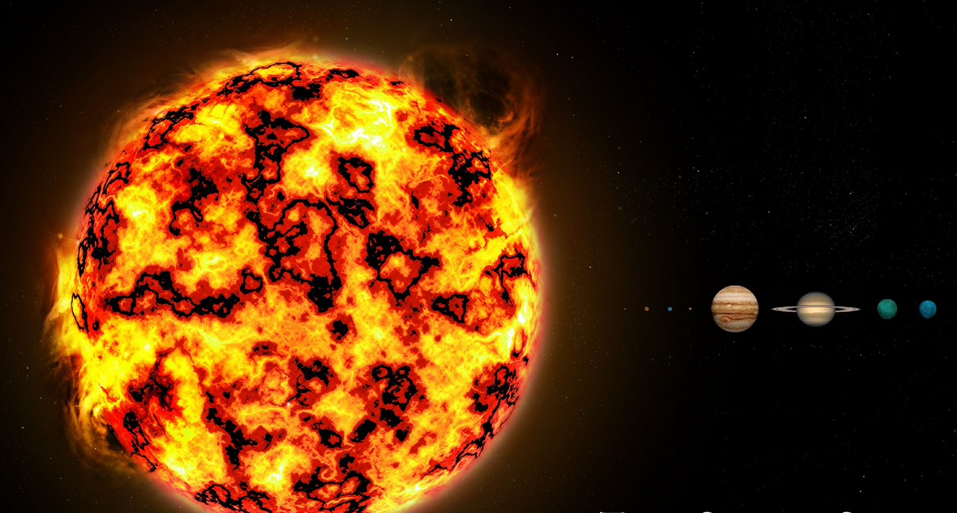
BioComputing Growth - NGS

Slide 11
Evolution of HPC
From Local to Global
Notes:
Differs from the traditional HPC in how nodes are provisioned

Slide 12
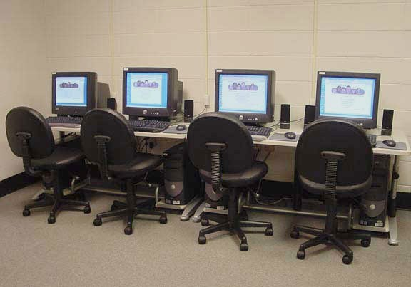
“Local” BioComputing

Slide 13
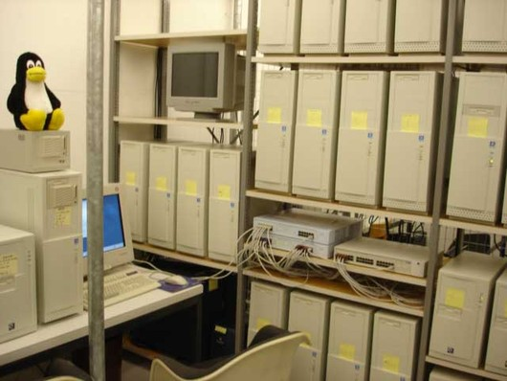
Early Grid BioComputing

Slide 15
Contemporary Cluster Specs
Storage and Networking:
2Pb – Lustre parallel file system
100Gbit networking, Infiniband Fabric
Computing nodes:
64 x 2.4GHz AMD Abu Dhabi cores
254gb of usable memory
1TB of local storage
Big memory nodes:
512Gb and 1TB memory with 48-80 cores
GPU nodes:
Tesla, Fermi, Kepler GPU classes

Slide 16
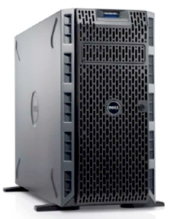
HPC Considerations
Scale

Slide 17
HPC Considerations
Computational capacity vs.
power and cooling

Slide 18
UF Data Center
UF Data Center on Eastside Campus
10,000 sq.ft and 1.75 MW total
5,000 sq. ft. space for Research Computing

Slide 19
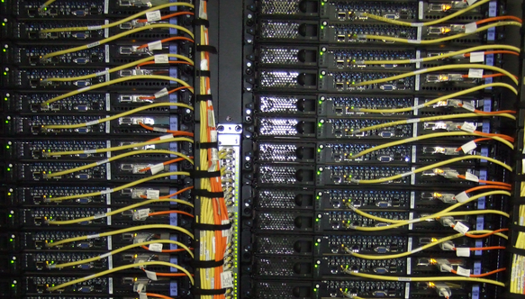
HPC Considerations
Interconnects
Networking

Slide 20
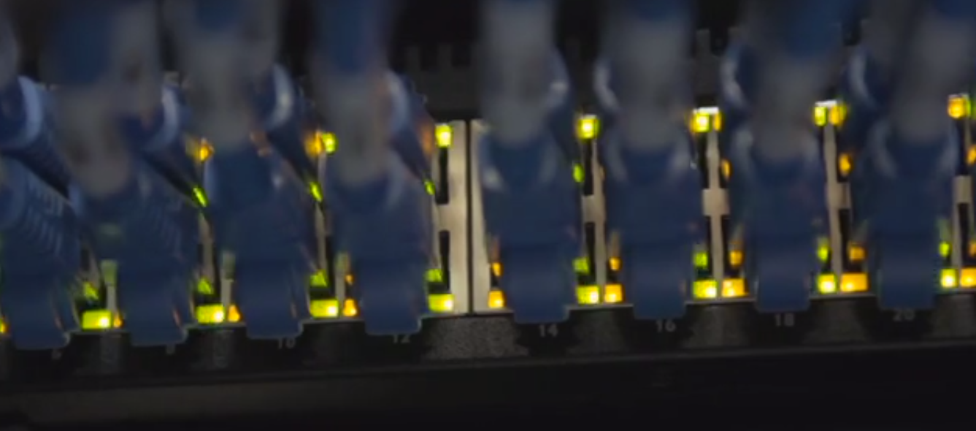
UF was 1st in the nation
Internet2 Innovation Platform
100 Gpbs connectivity
Campus Research Network now 200 Gbps

Slide 21
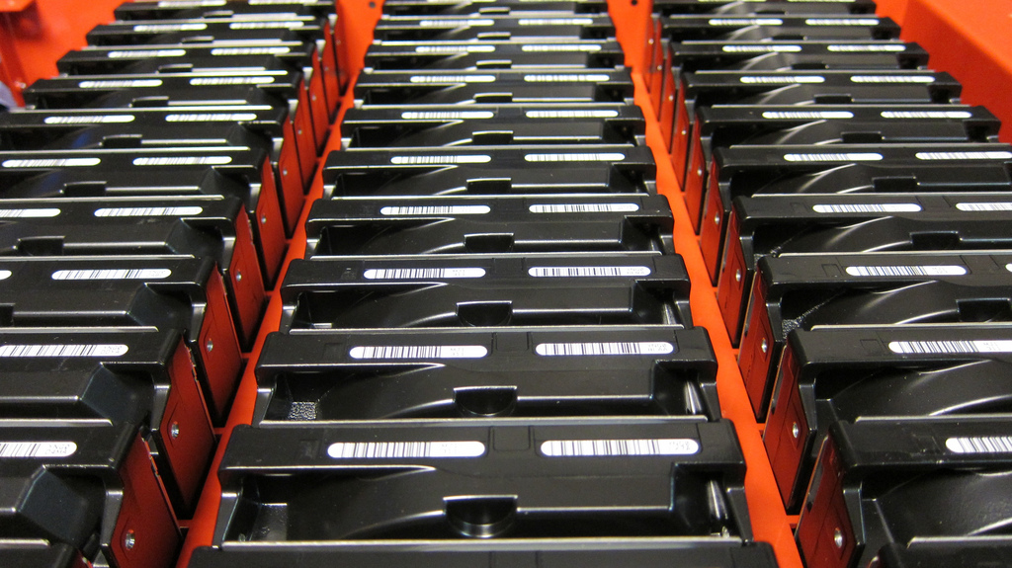
HPC Considerations
Storage
Parallel file systems
High I/O storage
Distributed storage

Slide 22
Scaling the HPC
The power of many
Notes:
Differs from the traditional HPC in how nodes are provisioned

Slide 24
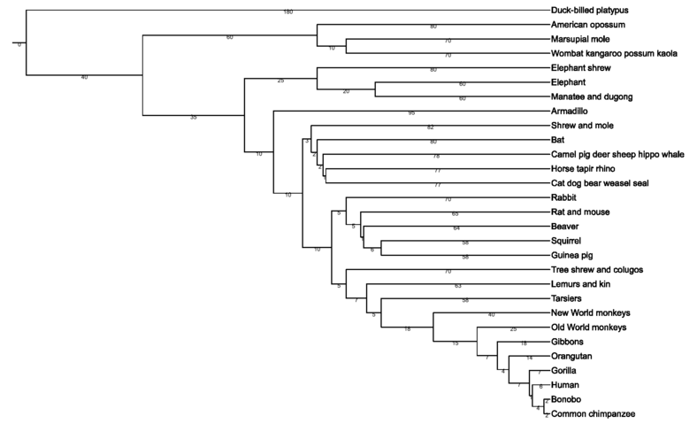
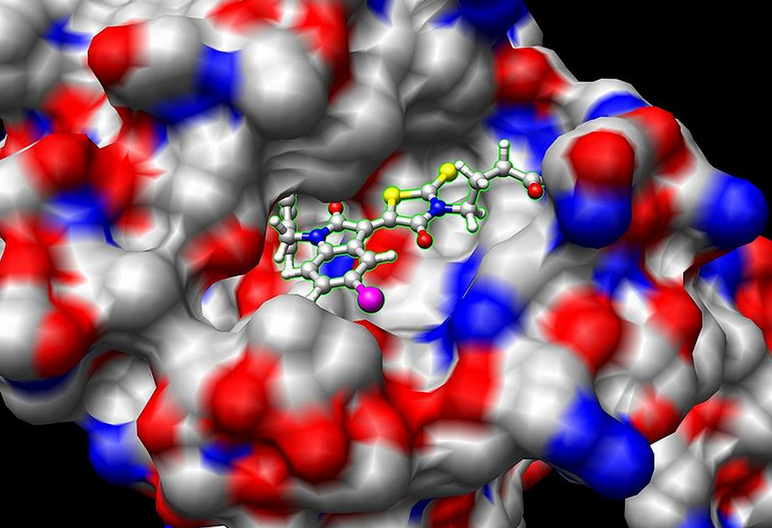
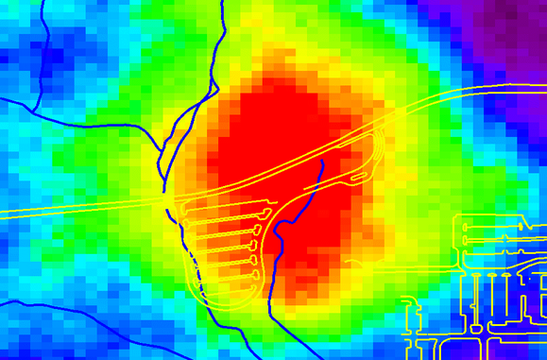
Computational Power
Modeling, phylogenetics, simulations

Slide 25
Traditional Computation
De-novo genome assembly
Short-read mapping
RNA-Seq
BS-Seq
CHIP-Seq
SNP calling
Pathway analysis
…
Why? Poor parallelization

Slide 26
Circumventing the Moore’s Law
Divide and conquer
Notes:
Differs from the traditional HPC in how nodes are provisioned

Slide 27
Traditional Parallel Computing
Split analyses manually, run separately
Multi-core (SMP) analyses with enabled software
Multi-node (MPI) analyses with specially constructed software

Slide 28
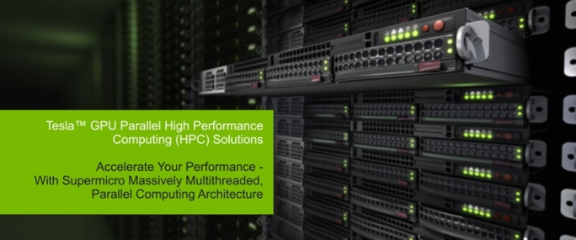
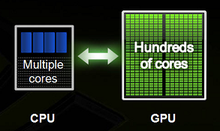
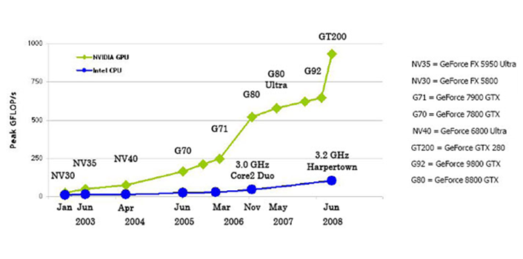
GPU Computing
Highly Parallelizable
Need the code!
CUDA

Slide 29
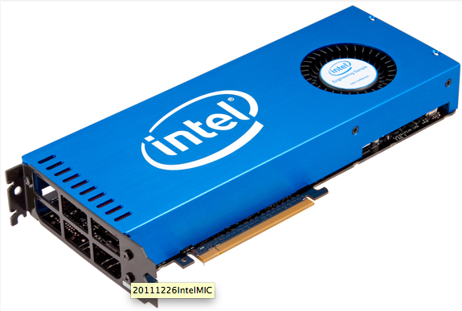
MIC Computing
Highly Parallelizable
Standard x86 cores
No need for learning a different programming paradigm ???

Slide 30
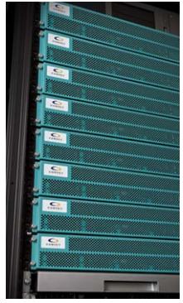
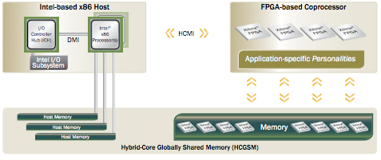
Specialized Processing
Notes:
Very expensive
Need specially constructed software
Niche applications
Need the payback

Slide 31
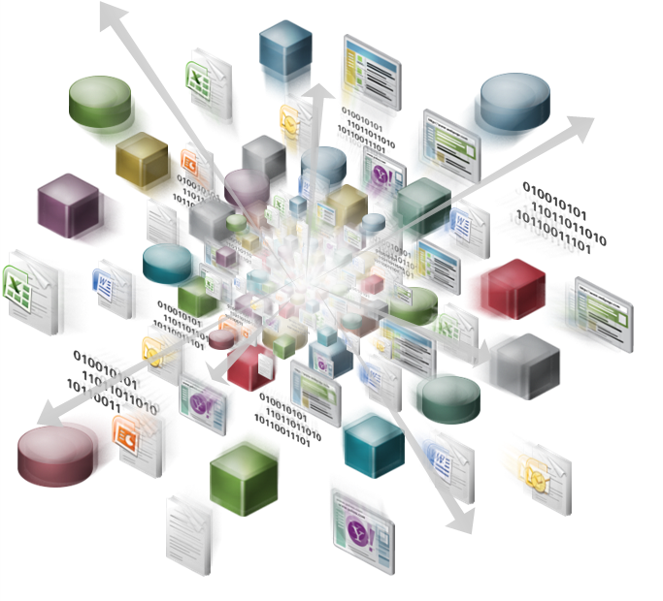
Distributed Computation (Hadoop)
BIG DATA
Results
Hypotheses
Patterns
Map-Reduce Approach
Notes:
Splitting vs. Parallelization
Examples
Modeling
Local sequence alignment
Simulations

Slide 32
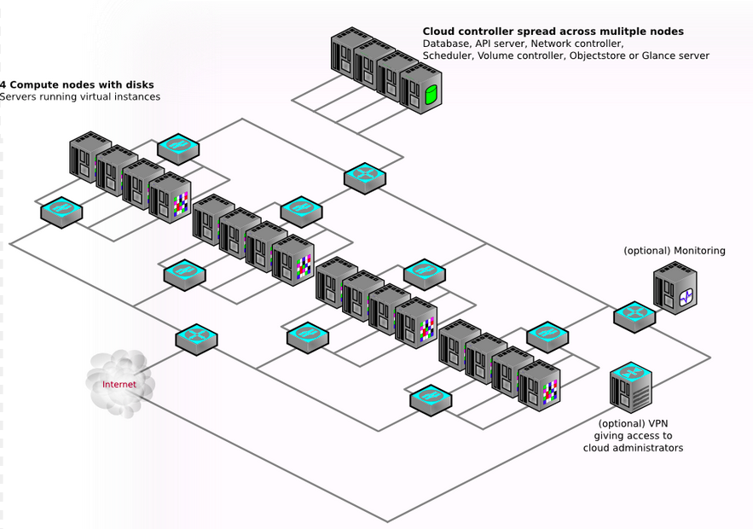
Biocomputing Cloud 9 ???
Notes:
Differs from the traditional HPC in how nodes are provisioned

Slide 33
Interfaces
Interfaces, Interfaces, Interfaces!!!
Notes:
Differs from the traditional HPC in how nodes are provisioned

Slide 34
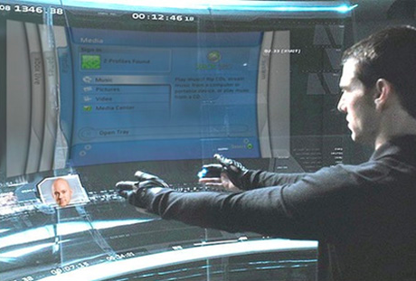
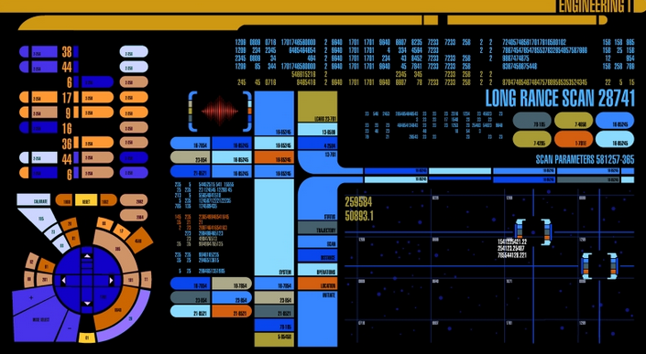
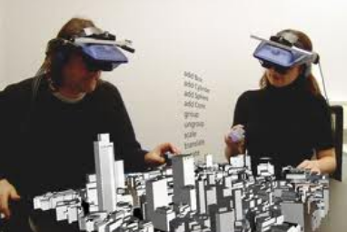
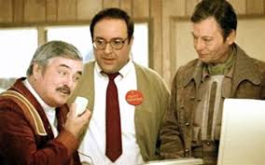
What the Future May Bring

Slide 35
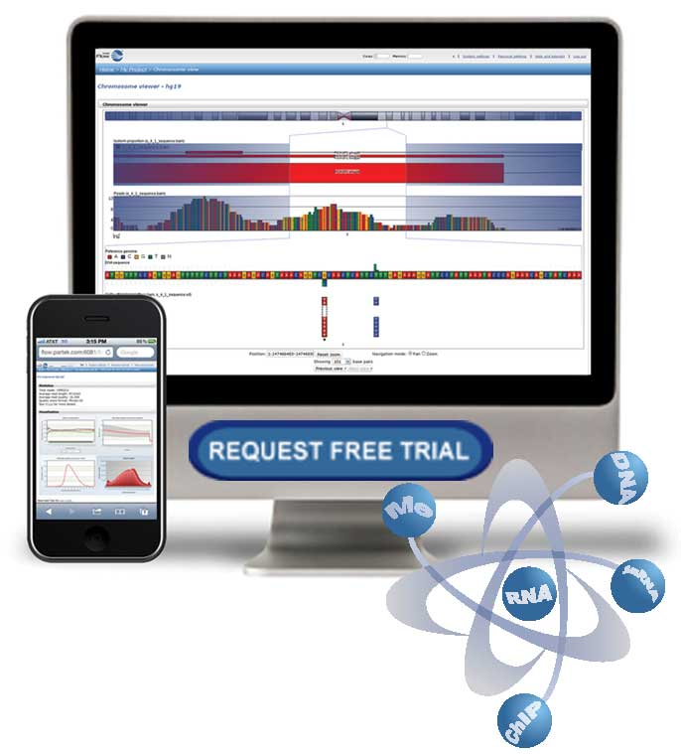
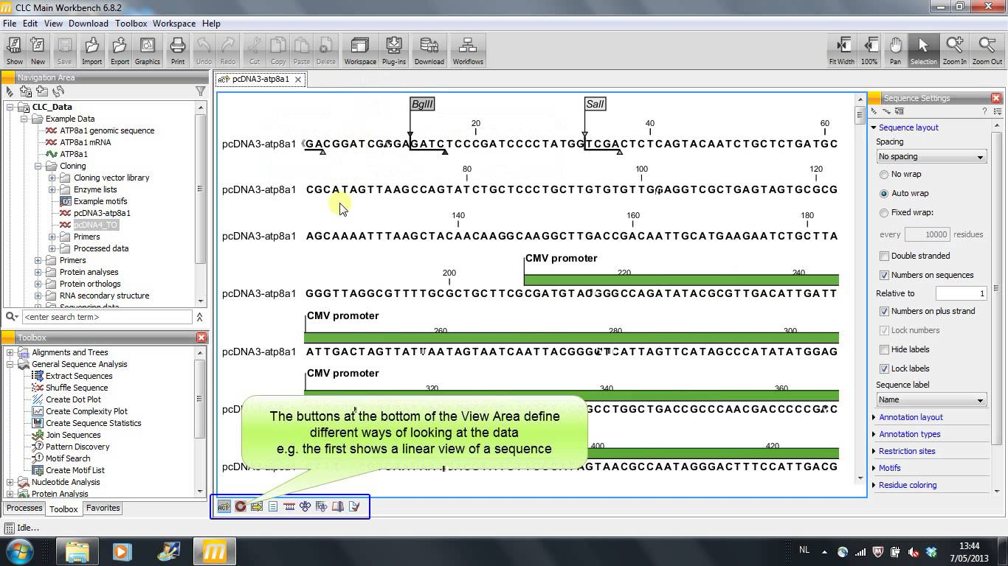
Graphical User Interfaces

Slide 36
Graphical User Interfaces
Proprietary applications
Graphical User Interface
Integrate multiple tools, pipelines
User friendly-wizards for analyses
Many can tie into servers or clusters
Often highly optimized
Expensive
Limited flexibility
Limited scalability
Proprietary algorithms

Slide 37
Web Interfaces

Slide 38
Web Interfaces
Galaxy
Free, Open Source
Public or private instance, physical or cloud-based
Web interface
Most applications can be integrated
User made pipelines
Moderately scalable
Integrating applications time consuming
User made pipelines—where to start? reliability?

Slide 39
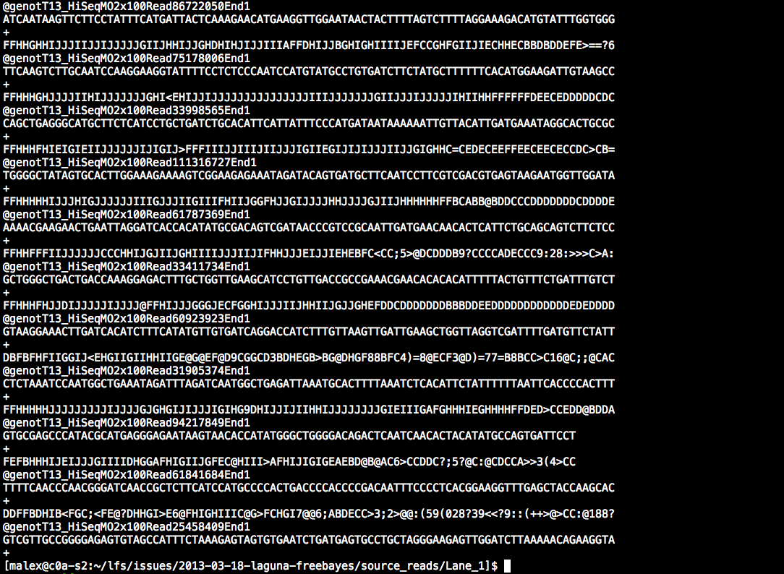
Batch Processing

Slide 40
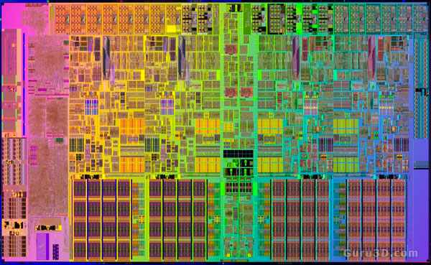
Batch Processing
User
interaction
Scheduler
Compute
resources
Tell the scheduler what you want to do
Login node
(Head node)
Your job runs on the cluster

Slide 41
Batch Processing
The Linux Command Line
Maximum flexibility
Most informatics tools run under Linux
Write your own tool, or script
Maximum scalability
Learning barrier of entry

Slide 42
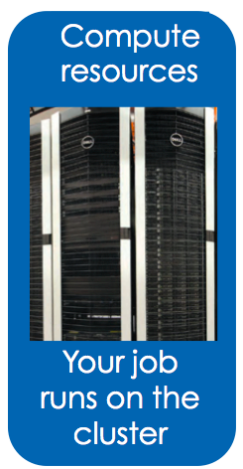
Batch processing
Scheduler
Submission Script
#!/bin/bash
#PBS -N My_Job_Name
#PBS -M Joe_Shmoe@ufl.edu
#PBS -m abe
#PBS -o My_Job.log
#PBS –e My_Job.err
#PBS -l nodes=1:ppn=1
#PBS -l walltime=00:05:00
#PBS –l pmem=900mb
cd $PBS_O_WORKDIR
date
module load test_app
test_app –i file.txt
Tell the scheduler what you want to do
Notes:
All #PBS need to go at top.

Slide 43
Accessing software via environment modules
module load trinity
Automatically:
Sets, $HPC_TRINITY_DIR
To run Inchworm, simply type
inchworm --reads reads.fa --run_inchworm [opts]
Loads Bowtie and Allpaths, two Trinity dependencies
You don’t need to hunt those down, or worry if they are in your path or not

Slide 44
It’s all in the software!
Matt Gitzendanner
UF Research Computing

Slide 45
Questions?
Thank you!

